Slide 1
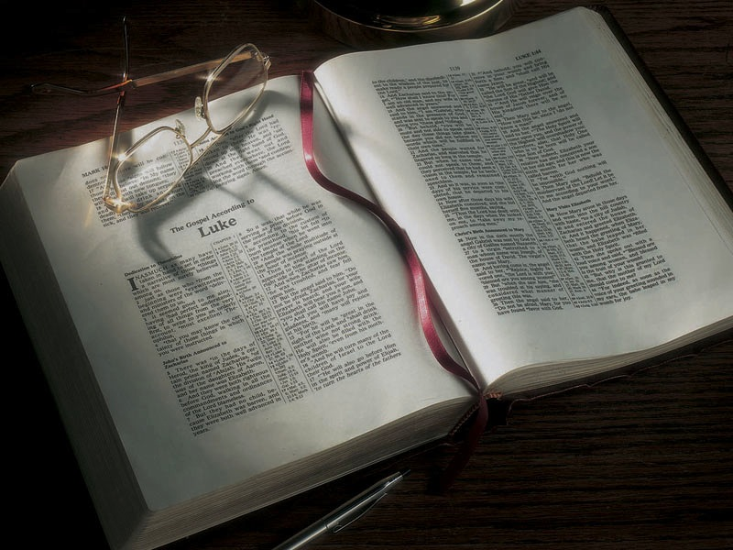

Slide 2
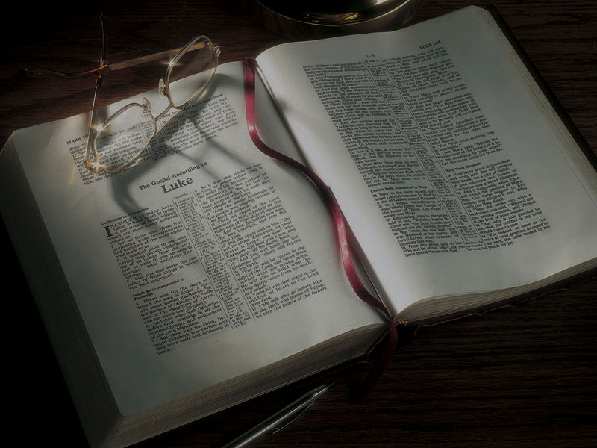
The Gospels
Jesus Christ’s Early Childhood

Slide 3
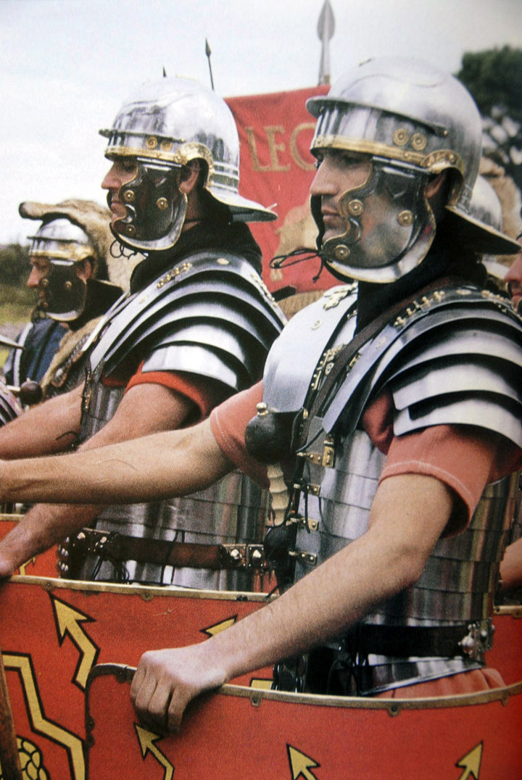

Slide 4
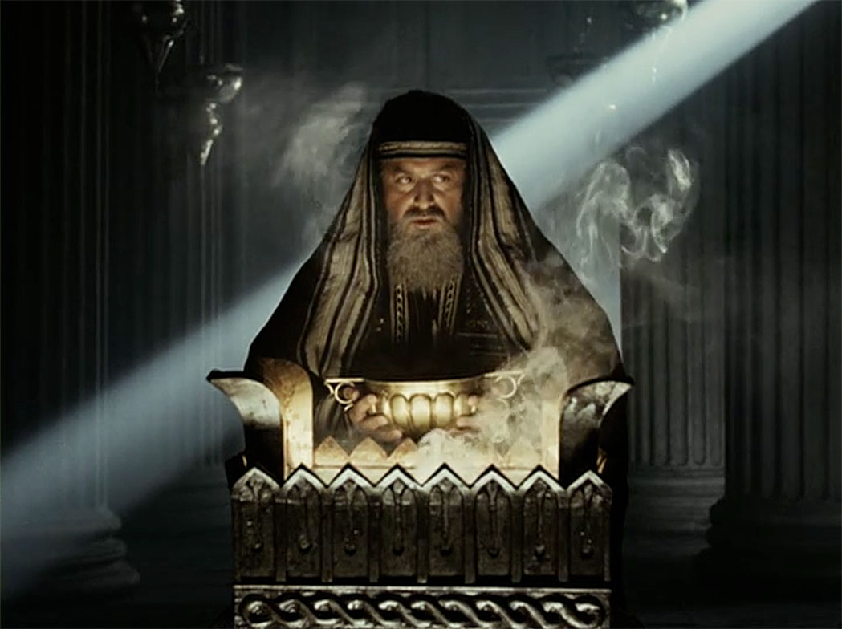

Slide 5
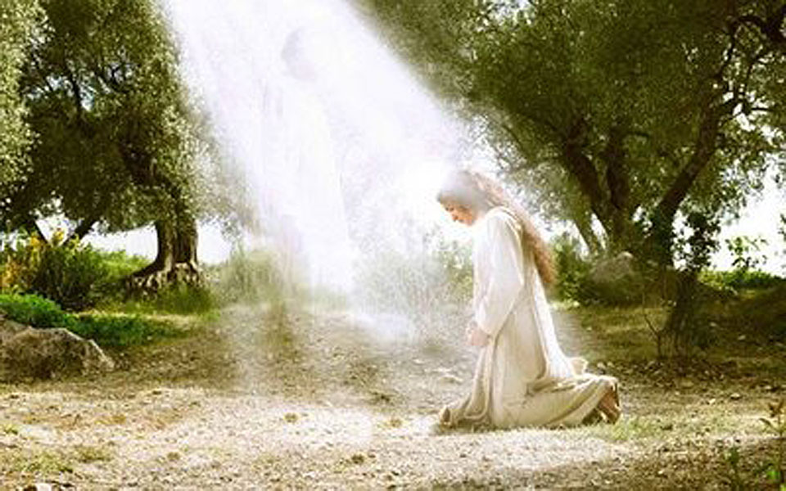

Slide 6
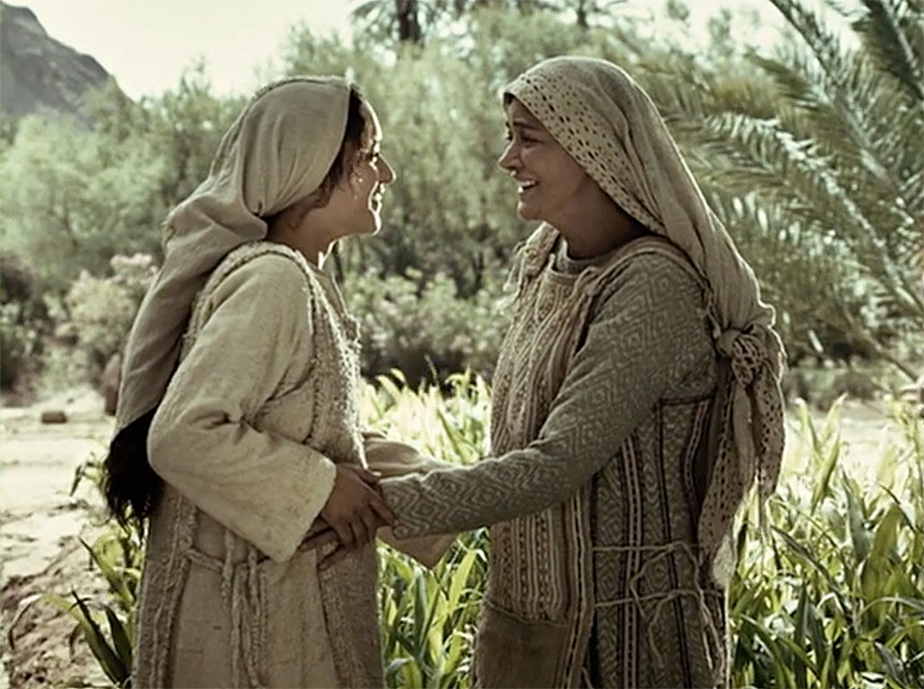

Slide 7
Luke 2:21-38
21 And when eight days were completed for the circumcision of the Child, His name was called JESUS, the name given by the angel before He was conceived in the womb.

Slide 8
Genesis 17:12
12 He who is eight days old among you shall be circumcised, every male child in your generations, he who is born in your house or bought with money from any foreigner who is not your descendant.
Leviticus 12:3
3 And on the eighth day the flesh of his foreskin shall be circumcised.

Slide 9
Luke 2:21-38
22 Now when the days of her purification according to the law of Moses were completed, they brought Him to Jerusalem to present Him to the Lord
23 (as it is written in the law of the Lord, “Every male who opens the womb shall be called holy to the LORD”),
24 and to offer a sacrifice according to what is said in the law of the Lord, “A pair of turtledoves or two young pigeons.”

Slide 10
Leviticus 12:6-8
6 When the days of her purification are fulfilled, whether for a son or a daughter, she shall bring to the priest a lamb of the first year as a burnt offering, and a young pigeon or a turtledove as a sin offering, to the door of the tabernacle of meeting.
…
8 And if she is not able to bring a lamb, then she may bring two turtledoves or two young pigeons—one as a burnt offering and the other as a sin offering . . .

Slide 11
Exodus 13:11-15
11 “And it shall be, when the LORD brings you into the land of the Canaanites, as He swore to you and your fathers, and gives it to you,
12 “that you shall set apart to the LORD all that open the womb, that is, every firstborn that comes from an animal which you have; the males shall be the LORD’S.…
14 “So it shall be, when your son asks you in time to come, saying, ‘What is this?’ that you shall say to him, ‘By strength of hand the LORD brought us out of Egypt, out of the house of bondage.

Slide 12
Exodus 13:11-15
15 ‘And it came to pass, when Pharaoh was stubborn about letting us go, that the LORD killed all the firstborn in the land of Egypt, both the firstborn of man and the firstborn of beast. Therefore I sacrifice to the LORD all males that open the womb, but all the firstborn of my sons I redeem.’

Slide 13
Numbers 18:15-16
15 Everything that first opens the womb of all flesh, which they bring to the LORD, whether man or beast, shall be yours; nevertheless the firstborn of man you shall surely redeem, and the firstborn of unclean animals you shall redeem.
16 And those redeemed of the devoted things you shall redeem when one month old, according to your valuation, for five shekels of silver, according to the shekel of the sanctuary, which is twenty gerahs.

Slide 14
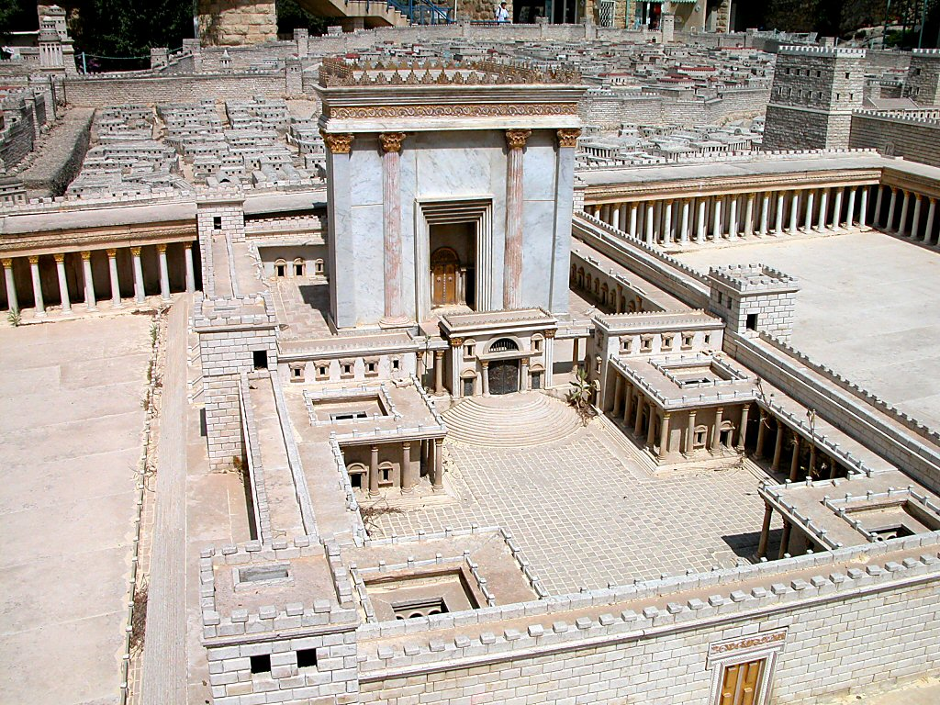
Jerusalem model Temple Court of Women from east
Notes:
The Balustrade
The Court of the Gentiles was separated from the Court of the Women by a balustrade 3 cubits (4.6 feet [1.4 m]) high known as the “Soreg.” Warnings to Gentiles against entry lined the outside of this fence. One complete inscription has been found and is on display in the Archaeological Museum of Istanbul. A fragmentary inscription can be seen in the Israel Museum.
tb051703214

Slide 15
Luke 2:21-38
25 And behold, there was a man in Jerusalem whose name was Simeon, and this man was just and devout, waiting for the Consolation of Israel, and the Holy Spirit was upon him.
26 And it had been revealed to him by the Holy Spirit that he would not see death before he had seen the Lord’s Christ.

Slide 16
Luke 2:21-38
27 So he came by the Spirit into the temple.
And when the parents brought in the Child Jesus, to do for Him according to the custom of the law,
28 he took Him up in his arms and blessed God and said:
29 “Lord, now You are letting Your servant depart in peace, according to Your word;
30 For my eyes have seen your salvation

Slide 17
Isaiah 52:10
10 The LORD has made bare His holy arm in the eyes of all the nations; and all the ends of the earth shall see the salvation of our God.

Slide 18
Luke 2:21-38
31 Which You have prepared before the face of all peoples, 32 A light to bring revelation to the Gentiles, and the glory of Your people Israel.”

Slide 19
Isaiah 9:2
2 The people who walked in darkness have seen a great light; those who dwelt in the land of the shadow of death, upon them a light has shined.
Isaiah 42:6
6 I, the LORD, have called You in righteousness, and will hold Your hand; I will keep You and give You as a covenant to the people, as a light to the Gentiles,

Slide 20
Isaiah 49:6
6 Indeed He says, ‘It is too small a thing that You should be My Servant to raise up the tribes of Jacob, and to restore the preserved ones of Israel; I will also give You as a light to the Gentiles, that You should be My salvation to the ends of the earth.’”

Slide 21
Isaiah 60:1-3
1 Arise, shine; for your light has come! And the glory of the LORD is risen upon you.
2 For behold, the darkness shall cover the earth, and deep darkness the people; but the LORD will arise over you, and His glory will be seen upon you.
3 The Gentiles shall come to your light, and kings to the brightness of your rising.

Slide 22
Luke 2:21-38
33 And Joseph and His mother marveled at those things which were spoken of Him.
34 Then Simeon blessed them, and said to Mary His mother, “Behold, this Child is destined for the fall and rising of many in Israel, and for a sign which will be spoken against

Slide 23
Romans 9:33
33 As it is written: “Behold, I lay in Zion a stumbling stone and rock of offense, and whoever believes on Him will not be put to shame.”
Isaiah 8:13-14
13 The LORD of hosts, Him you shall hallow; let Him be your fear, and let Him be your dread.
14 He will be as a sanctuary, but a stone of stumbling and a rock of offense to both the houses of Israel, as a trap and a snare to the inhabitants of Jerusalem.

Slide 24
Luke 2:21-38
35 “(yes, a sword will pierce through your own soul also), that the thoughts of many hearts may be revealed.”

Slide 25
Luke 2:21-38
36 Now there was one, Anna, a prophetess, the daughter of Phanuel, of the tribe of Asher. She was of a great age, and had lived with a husband seven years from her virginity;
37 and this woman was a widow of about eighty-four years, who did not depart from the temple, but served God with fastings and prayers night and day.
38 And coming in that instant she gave thanks to the Lord, and spoke of Him to all those who looked for redemption in Jerusalem.

Slide 26
Deuteronomy 19:15
15 By the mouth of two or three witnesses the matter shall be established.

Slide 27
Luke 2:21-38
(Simeon)
29 “Lord, now You are letting Your servant depart in peace, According to Your word;
30 For my eyes have seen Your salvation
31 Which You have prepared before the face of all peoples,
32 A light to bring revelation to the Gentiles, And the glory of Your people Israel.”

Slide 28
Luke 2:21-38
(Anna)
38 And coming in that instant she gave thanks to the Lord, and spoke of Him to all those who looked for redemption in Jerusalem.

Slide 29
Matthew 2:1-12
2:1 Now after Jesus was born in Bethlehem of Judea in the days of Herod the king, behold, wise men from the East came to Jerusalem,
2 saying, “Where is He who has been born King of the Jews? For we have seen His star in the East and have come to worship Him.”
3 When Herod the king heard this, he was troubled, and all Jerusalem with him.

Slide 30
Matthew 2:1-12
4 And when he had gathered all the chief priests and scribes of the people together, he inquired of them where the Christ was to be born.
5 So they said to him, “In Bethlehem of Judea, for thus it is written by the prophet:
6 ‘But you, Bethlehem, in the land of Judah, are not the least among the rulers of Judah; for out of you shall come a Ruler Who will shepherd My people Israel.’”

Slide 31
Micah 5:2
2 But you, Bethlehem Ephrathah, though you are little among the thousands of Judah, yet out of you shall come forth to Me the One to be Ruler in Israel, Whose goings forth are from of old, from everlasting.

Slide 32
Matthew 2:1-12
7 Then Herod, when he had secretly called the wise men, determined from them what time the star appeared.
8 And he sent them to Bethlehem and said, “Go and search carefully for the young Child, and when you have found Him, bring back word to me, that I may come and worship Him also.”

Slide 33
Matthew 2:1-12
9 When they heard the king, they departed; and behold, the star which they had seen in the East went before them, till it came and stood over where the young Child was.
10 When they saw the star, they rejoiced with exceedingly great joy.
11 And when they had come into the house, they saw the young Child with Mary His mother, and fell down and worshiped Him. And when they had opened their treasures, they presented gifts to Him: gold, frankincense, and myrrh.

Slide 34
Matthew 2:1-12
9 When they heard the king, they departed; and behold, the star which they had seen in the East went before them, till it came and stood over where the young Child was.
10 When they saw the star, they rejoiced with exceedingly great joy.
11 And when they had come into the house, they saw the young Child with Mary His mother, and fell down and worshiped Him. And when they had opened their treasures, they presented gifts to Him: gold, frankincense, and myrrh.

Slide 35
Exodus 30:34-37
34 And the LORD said to Moses: “Take sweet spices, stacte and onycha and galbanum, and pure frankincense with these sweet spices; there shall be equal amounts of each.
35 “You shall make of these an incense, a compound according to the art of the perfumer, salted, pure, and holy . . .
37 “But as for the incense which you shall make, you shall not make any for yourselves, according to its composition. It shall be to you holy for the LORD.

Slide 36
John 19:39-40
39 And Nicodemus, who at first came to Jesus by night, also came, bringing a mixture of myrrh and aloes, about a hundred pounds.
40 Then they took the body of Jesus, and bound it in strips of linen with the spices, as the custom of the Jews is to bury.

Slide 37
Matthew 2:13-18
13 Now when they had departed, behold, an angel of the Lord appeared to Joseph in a dream, saying, “Arise, take the young Child and His mother, flee to Egypt, and stay there until I bring you word; for Herod will seek the young Child to destroy Him.”
14 When he arose, he took the young Child and His mother by night and departed for Egypt,
15 and was there until the death of Herod, that it might be fulfilled which was spoken by the Lord through the prophet, saying, “Out of Egypt I called My Son.”

Slide 38
Matthew 2:13-18
16 Then Herod, when he saw that he was deceived by the wise men, was exceedingly angry; and he sent forth and put to death all the male children who were in Bethlehem and in all its districts, from two years old and under, according to the time which he had determined from the wise men.

Slide 39
Matthew 2:13-18
17 Then was fulfilled what was spoken by Jeremiah the prophet, saying:
18 “A voice was heard in Ramah, lamentation, weeping, and great mourning, Rachel weeping for her children, refusing to be comforted, because they are no more.”
(quoting Jeremiah 31:15)

Slide 40
Genesis 35:16-19
16 Then they journeyed from Bethel. And when there was but a little distance to go to Ephrath, Rachel labored in childbirth, and she had hard labor.
17 Now it came to pass, when she was in hard labor, that the midwife said to her, “Do not fear; you will have this son also.”
18 And so it was, as her soul was departing (for she died), that she called his name Ben-Oni; but his father called him Benjamin.
19 So Rachel died and was buried on the way to Ephrath (that is, Bethlehem).

Slide 41
Revelation 12:3-5
3 And another sign appeared in heaven: behold, a great, fiery red dragon having seven heads and ten horns, and seven diadems on his heads.
4 His tail drew a third of the stars of heaven and threw them to the earth. And the dragon stood before the woman who was ready to give birth, to devour her Child as soon as it was born.
5 She bore a male Child who was to rule all nations with a rod of iron. And her Child was caught up to God and His throne.

